Slide 1

Version Control
git
ITI - Day 2

Slide 2

Content
1
Branching & Rebasing
2
Pull Request
3
Tagging &
Versioning
4
Ignoring
Files

Slide 3
Branching & Rebasing

Slide 4
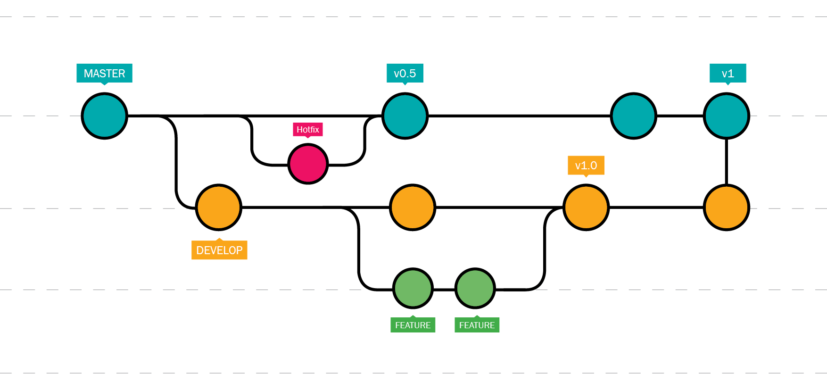
Branching Out

Slide 5

Branching Out
To list all the branches
git branch
To make a new branch.
git branch new_branch_name
To switch to a branch
git checkout branch_name
To create a branch and
checkout it in one step
git checkout -b new_branch_name

Slide 6
Create a Remote Branch
When you need another people to work on your branch
Then you have to make your branch available remotely
git push origin branch_name
To list remote branches
git branch -r

Slide 7
Remove a Branch
To delete a remote branch
git push origin :branch_name
To delete a local branch
git branch -d branch_name

Slide 8
Merging Branches
After finishing your work on the branch,
you’ve to merge it with the Master branch.
First, go to the Master branch
git checkout master
Then, merge the two branches with each other
git merge branch_name

Slide 9
Git Rebase
Master
Dev

Slide 10
Git Rebase
Master
Dev

Slide 11
Pull Request

Slide 12
Pull Request
Pull requests let you tell others about changes you've pushed to a branch in a repository on GitHub.
Once a pull request is opened, you can discuss and review the potential changes with collaborators and add follow-up commits before your changes are merged into the base branch.

Slide 13

Demo on GitHub

Slide 14
Tagging & Versioning

Slide 15
Tagging
A tag is a reference to a commit - used mostly in release versioning.
Git supports two types of tags:
Lightweight
Annotated.

Slide 16
Tags Types
To create a lightweight tag
git tag v1.0
To create an annotated tag
git tag -a v2.0 -m “version 2.0”

Slide 17
Push Tags
To list all tags
git tag
To push tags
git push origin <tag_name>
git push --tags

Slide 18
Delete Tags
To delete remote tag
git push origin --delete v1.0
To delete local tags
git tag -d v1.0

Slide 19
Ignoring Files

Slide 20
Ignoring Files
Often, you will have a class of files that you don’t want git to automatically add or even show to you as being untracked.
In such cases you can create a file called .gitignore to contains all the unwanted files or directories.
cache/
logs/*.log

Slide 21
Lab 2
Create a new project on your local machine,
then push it your remote repo.
Create two branches (dev & test) then create one
file on each branch, and push this changes to the remote repo.
Merge this changes on Master branch and then push it to your
remote master branch.
Tell me how to remove dev branch locally and remotely.
Send an invitation to me (ahmedibrahem22322@gmail.com).

Slide 22
Lab 2
Create an annotated tag with tagname (v1.7) .
Push it to the remote repository.
Tell me how to list tags.
Tell me how to delete tag locally and remotely.
Add an image in the README.md file.

Slide 23

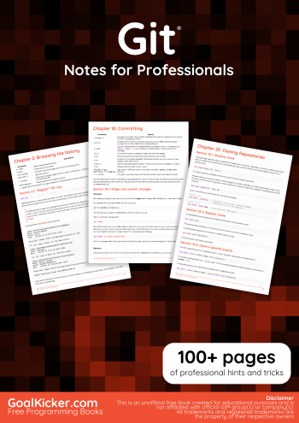
R
E
S
O
U
R
C
E
S
Pro Git - Second Edition
Git - Notes for Professionals

Slide 24
Thanks!
Do you have any questions?
Email: asamy0037@gmail.com
Whatsapp: 01007591795

